Slide 1
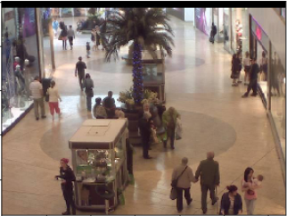
Capstone 2
Crowd Counting with a Convolutional Neural Network David Abelseth

Slide 2
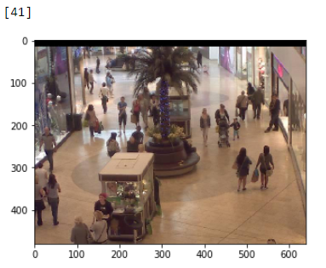
Crowd Counting - Preface
Goal: Given a picture of a mall webcam, count the number of people in the frame using a convolutional neural network.
For example, there are 41 people in the frame below:

Slide 3
Application of Crowd Counting
There are many applications of crowd counting. Some of which include:
Counting crowds could act as a proxy for overall retail economic conditions.
Crowd counting for specific retailers could provide the basis for long/short stock purchases
A mall could offer high traffic areas to specific retailers and charge more (ex. Apple)
The feature extraction process for counting a crowd could be useful for other applications through transfer learning (ex. Crowd counting at a political rally, estimations of animal populations using a webcam in the forest etc.)
Further advances in a crowd counting context could provide additional details on people in the image (demographics, time of day, etc.)

Slide 4
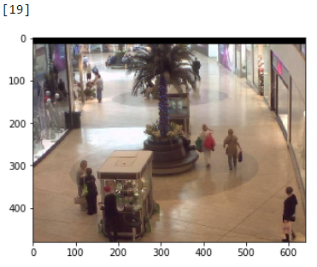
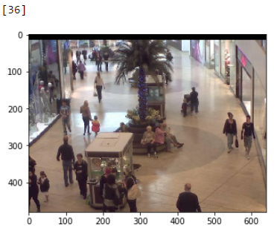
Data Collection
The data was sourced from associate professor Chen Change Loy’s personal website.
http://personal.ie.cuhk.edu.hk/~ccloy/downloads_mall_dataset.html
The dataset contains 2,000 images from a mall webcam. Each image has an associated target value which represents the number of people in the frame.
Examples from the dataset:

Slide 5
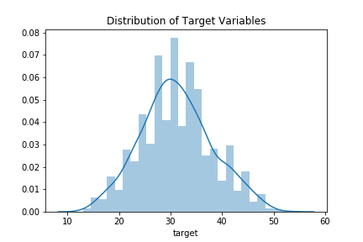
Explanatory Data Analysis
To get a sense of the distribution of the data, a histogram of the target variables was plotted
The dataset has a mean target value of 31.16

Slide 6
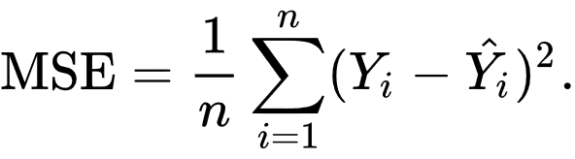
Performance Benchmarking
In order to set a performance benchmark the mean squared error was calculated on the dataset
Subsequent model training was then benchmarked to the calculated MSE
MSE of dataset = 48.21

Slide 7
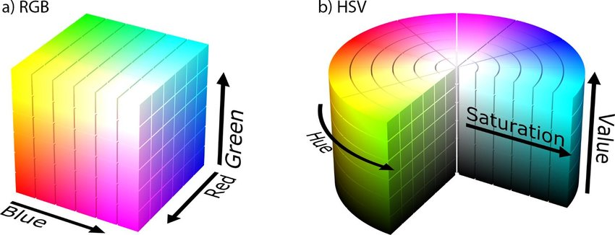
Data Preprocessing – Conversion to HSV
In order to simplify the tensor input into the CNN, the dataset was converted from RGB to HSV
From the HSV images, the “value” was extracted for training
The conversion was done due to the network not requiring 3 dimensions to count the individuals in the frame¹.
1 – Training on RGB vs “value” from HSV had marginal differences

Slide 8
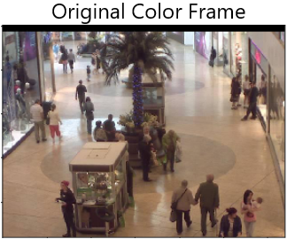
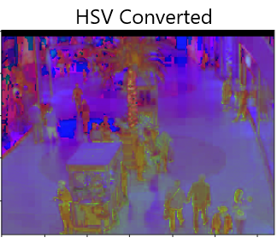
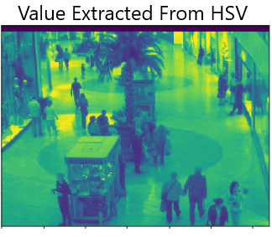
Data Preprocessing – Conversion to HSV
Example of image transformation

Slide 9
Part 1 – Initial Training
8 models were initially trained
Slight modifications were made to each model to show the impact
Initial training shows a model with dropout and leakyrelu performs best
Model | Model Name | # of layers | DO | BN | Activation | Parameters | Val MSE
1 | Basic CNN | 1 |  |  | Relu | 130,515,833 | 15.77
2 | Basic CNN v2 | 2 |  |  | Relu | 62,891,665 | 11.35
3 | Basic CNN v2 DO | 2 | X |  | Relu | 62,891,665 | 44.41
4 | Basic CNN v2 BN | 2 |  | X | Relu | 62,893,073 | 11.01
5 | Basic CNN v2 DO LR | 2 | X |  | LeakyRelu | 62,891,665 | 10.56
6 | Basic CNN v2 BN LR | 2 |  | X | LeakyRelu | 62,893,073 | 10.66
7 | AlexNet Transfer Learning¹ | 7 | X | X | Relu | 13,011,313 | 244.97
8 | AlexNet Transfer Learning LR¹ | 7 | X | X | LeakyRelu | 13,014,257 | 19.53
^{[1]} Transfer learning model – Variations made to the Alexnet architecture: https://papers.nips.cc/paper/4824-imagenet-classification-with-deep-convolutional-neural-networks.pdf

Slide 10
Part 2 – Improving AlexNet Transfer Learning
In an attempt to improve models 7 & 8 (variations of AlexNet), further adjustments were made to the AlexNet
4 additional variations of AlexNet were trained.
None of which performed better than model 5 from Part 1 (10.56 MSE)
Model | Model Name | # of layers | DO | BN | Activation | Parameters | Val MSE
9 | AlexNet trasfer actual | 8 | X | X | Relu | 110,887,769 | 23.08
10 | AlexNet transfer DO | 8 | X |  | Relu | 110,882,265 | 28.80
11 | AlexNet transfer BE | 8 |  | X | Relu | 110,887,769 | 15.69
12 | AlexNet transfer BE LR | 8 |  | X | LeakyRelu | 110,887,769 | 12.86

Slide 11
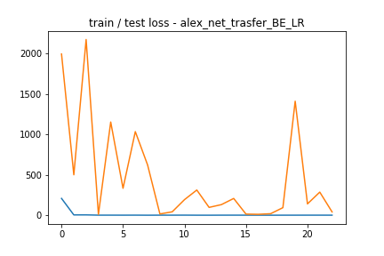
Part 2 – Improving AlexNet Transfer Learning
Model 12 performed the best, however, the validation MSE fluxuated substantially This could suggest overfitting
Model | Model Name | # of layers | DO | BN | Activation | Parameters | Val MSE
12 | AlexNet transfer BE LR | 8 |  | X | LeakyRelu | 110,887,769 | 12.86

Slide 12
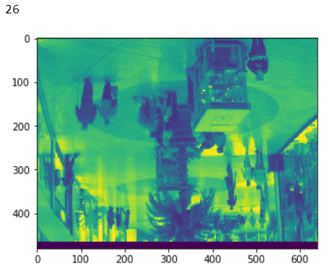
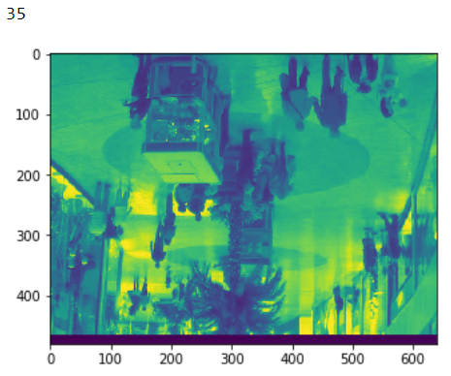
Part 3 – Augmenting the training sample
To attempt to fix the issue of overfitting, the dataset was augmented using the Keras ImageDataGenerator class
2,000 additional images were generated, The images were randomly flipped on the X & Y axis
Below are two examples of the generated image output:

Slide 13
Part 3 – Augmenting the training sample
Training the top 6 models from Part 1 & 2 on the augmented dataset results in the following results:
Model | Model Name | # of layers | DO | BN | Activation | Parameters | Original | Aug¹
5 | Basic CNN v2 DO LR | 2 | X |  | LeakyRelu | 62,891,665 | 10.56 | 14.00
6 | Basic CNN v2 BN LR | 2 |  | X | LeakyRelu | 62,893,073 | 10.66 | 27.24
7 | AlexNet Transfer Learning⁶ | 7 | X | X | Relu | 13,011,313 | 244.97 | 328.51
8 | AlexNet Transfer Learning LR | 7 | X | X | LeakyRelu | 13,014,257 | 19.53 | 20.40
11 | AlexNet transfer BE | 8 |  | X | Relu | 110,887,769 | 15.69 | 24.46
12 | AlexNet transfer BE LR | 8 |  | X | LeakyRelu | 110,887,769 | 12.86 | 42.72
1 - Trained on augmented sample

Slide 14
Part 3 – Augmenting the training sample
Models trained on the augmented dataset saw validation MSE increase across the board. This may suggest that the current models are doing an inadequate job of filtering out the features of people upsidedown.
Excluding model 7, the models that had Dropout appeared to perform better than those that did not This might suggest drop out is more effective in the training of the models
Model | Model Name | # of layers | DO | BN | Activation | Parameters | Original | Aug¹
5 | Basic CNN v2 DO LR | 2 | X |  | LeakyRelu | 62,891,665 | 10.56 | 14.00
6 | Basic CNN v2 BN LR | 2 |  | X | LeakyRelu | 62,893,073 | 10.66 | 27.24
7 | AlexNet Transfer Learning⁶ | 7 | X | X | Relu | 13,011,313 | 244.97 | 328.51
8 | AlexNet Transfer Learning LR | 7 | X | X | LeakyRelu | 13,014,257 | 19.53 | 20.40
11 | AlexNet transfer BE | 8 |  | X | Relu | 110,887,769 | 15.69 | 24.46
12 | AlexNet transfer BE LR | 8 |  | X | LeakyRelu | 110,887,769 | 12.86 | 42.72
1 - Trained on augmented sample

Slide 15
Part 4 – Sample Mean Normalization
In an attempt to improve the models ability to pick up on changes in a frame, the dataset was normalized with the mean image prior to training. The goal was to further accentuate the features in the dataset.
The normalization process was done by subtracting the mean image from each frame and then taking the absolute value of the result.
The mean normalization process effectively makes the models ungeneralizable. (ex. The model would not work on a different mall webcam without a separate dataset)
Mathematically, the normalization process is given as follows:

Slide 16
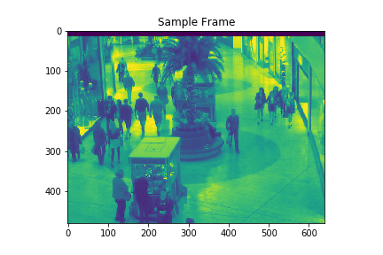
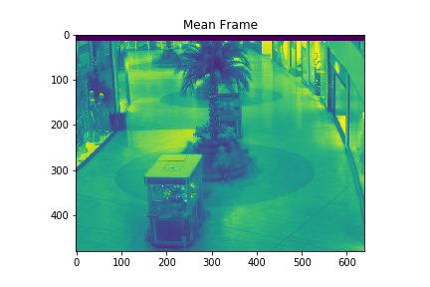
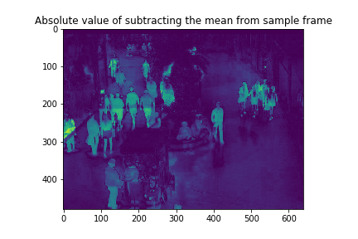
Part 4 – Sample Mean Normalization
Below is an example of the mean normalized frames
-
=
-
=

Slide 17
Part 4 – Sample Mean Normalization
With the exception of model 7, validation MSE performance worsened across the board
The improvement in model 7 might suggest that the model has a problem with “exploding gradients” Normalizing the data likely makes the Relu activations less sensitive to changes in the frame
The decrease in validation MSE in the 5 models is likely due to the models already being able to pick up on minor changes in the frame.
Model | Model Name | # of layers | DO | BN | Activation | Parameters | Original | Aug¹ | MN²
5 | Basic CNN v2 DO LR | 2 | X |  | LeakyRelu | 62,891,665 | 10.56 | 14.00 | 16.69
6 | Basic CNN v2 BN LR | 2 |  | X | LeakyRelu | 62,893,073 | 10.66 | 27.24 | 78.53
7 | AlexNet Transfer Learning⁶ | 7 | X | X | Relu | 13,011,313 | 244.97 | 328.51 | 28.36
8 | AlexNet Transfer Learning LR | 7 | X | X | LeakyRelu | 13,014,257 | 19.53 | 20.40 | 34.48
11 | AlexNet transfer BE | 8 |  | X | Relu | 110,887,769 | 15.69 | 24.46 | 16.20
12 | AlexNet transfer BE LR | 8 |  | X | LeakyRelu | 110,887,769 | 12.86 | 42.72 | 14.57
1 - Trained on augmented data
2 - Trained on mean normalized data

Slide 18
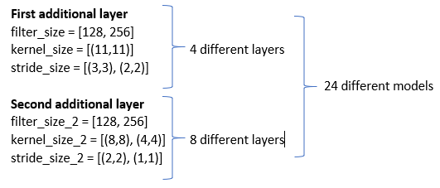
Part 5 – Automating the CNN Training
In a final attempt to improve the model performance from Part 1, a script was created to automate the model building process. The script adds two additional convolutional layers to the best performing model from Part 1 (model 5)
The cartesian product of 2 additional layers was taken
The cartesian product of the results was then taken to generate 24 additional models to train
The 24 models were trained and the model with the best performance was written to a text file

Slide 19
Part 5 – Automating the CNN Training
Of the 24 models trained, the best model performed at 15.64 validation MSE
Again, adding complexity to the model did not improve model performance
Next Steps:
In order to improve model performance, additional models need to be trained
24 models were trained, however, increasing this number by a factor of 2 or 3 might provide an improvement on performance

Slide 20
Conclusion and Next Steps
One of the simplest models performed the best at a mean squared error of 10.56 (2 CNN layers & 62,891,665 trainable parameters)
LeakyRelu improved performance on models with “exploding gradient” issues
Drop out appears to be more effective in improving model performance than batch normalization
The models are adequately capable of picking up on small differences in the images (ie. No mean normalization is required)
Adding complexity to the models did not improve performance. Additional training with various model variations is required in order to improve overall performance of the model.

